Slide 1
An intro into the life of
AHMED SADIQ ALVI
PLEASE WATCH THIS IN SLIDESHOW

Slide 2

Early days:
Born someday in 2001 this person was among a group of twins born that day. That is when the misery began.
He slowly grew up in a hostile life surrounded by his elder siblings who were mentally as young as him.
This harsh environment caused him to grow up more mature than any of his pears around him
His unusual childhood propelled him into gaining odd taste in life unlike the children around him he had the taste of an old man

Slide 3


His weird taste in movies
His love for the movie that was made in the years his grand father was young was surely something people were afraid of .

Slide 4
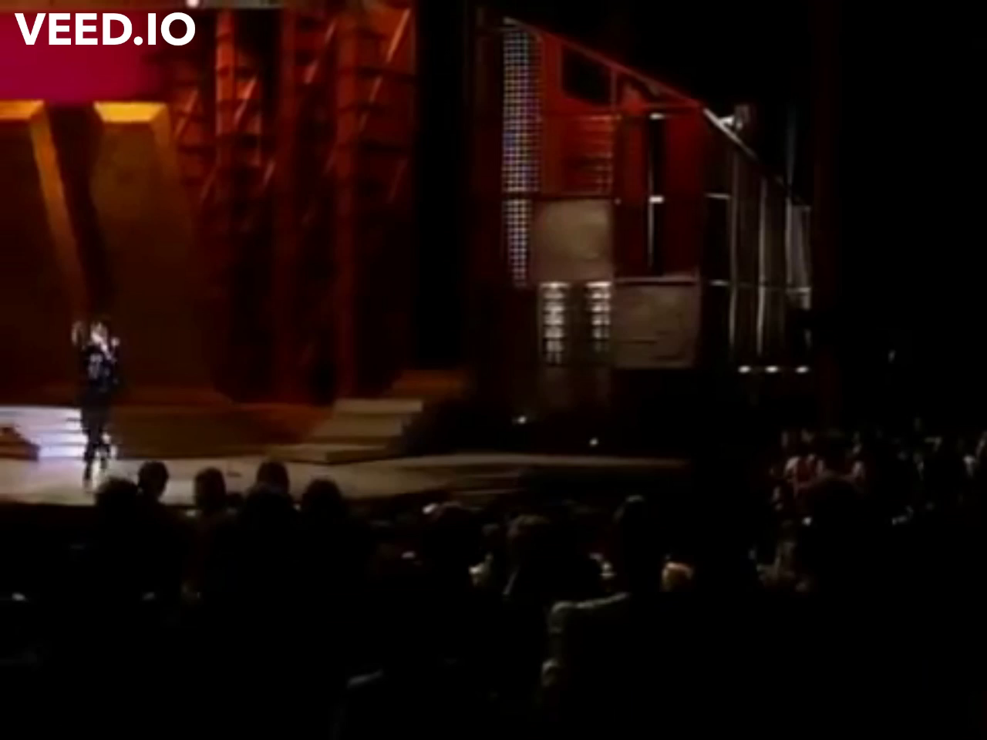
Taste in music
What was worse was his great passion for older Michael Jackson songs

Slide 5

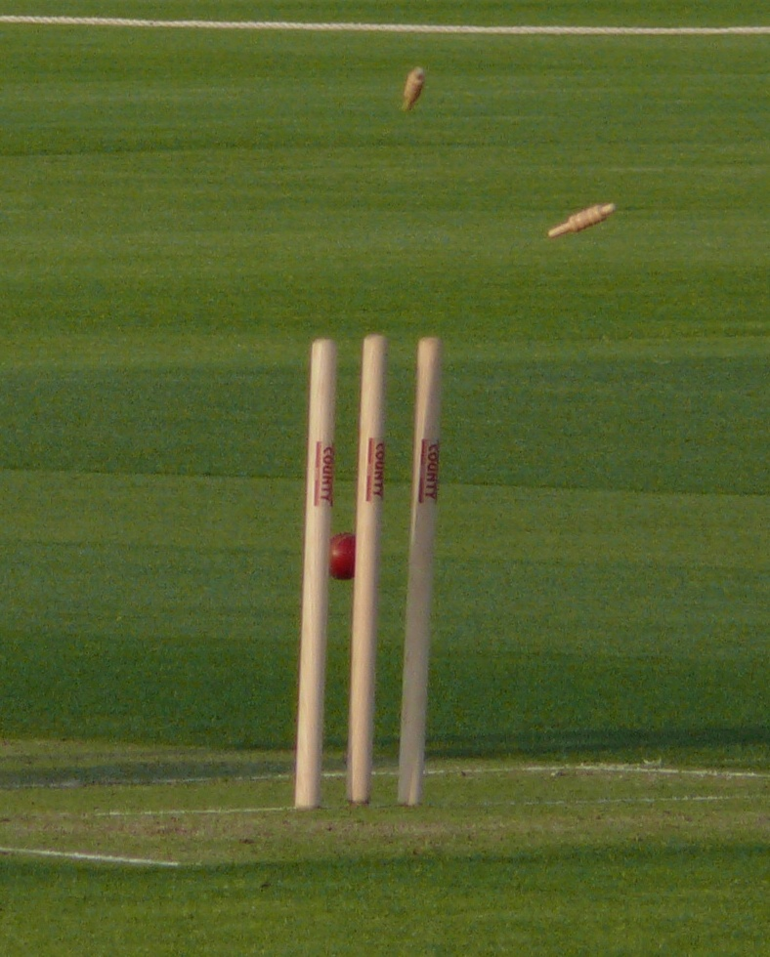

After growing older my passions shifted
The love for the sports had engulfed him
As he always had to compete against his elder siblings his resilience was astounding even for him
Starting with basketball then cricket and then football my love for the thrill in sport increased
This Photo by Unknown Author is licensed under CC BY-SA-NC

Slide 6

This passion of his was followed the passion of mistery solving

Slide 7
ADOLESCENTS'
My happy days were followed by the great depression.
Enjoyments of life were halted as this mature kid started dealing with the horrors of education.
Traumatized by this the man child finally reverted to being a child
Unfortunately for him his peers were now adults.

Slide 8
Now
As of today, this 20-year-old man who still has a mind of a ten-year-old walks the halls of IBA

Slide 9

The end
Thank you for your time.
Ps. Some information is fictionalized
(the weird tastes are real)

